Slide 1
Embedded Hardware: Hardware Building Blocks
CSPC61 - Embedded Systems Architectures
Board I/O
Dr. M. Bhuvaneswari
11.03.2022

Slide 2
Topics - Board I/O (Input/Output)
Introducing board I/O
Discussing differences between serial and parallel I/O
Introducing interfacing to I/O
Discussing I/O performance

Slide 3
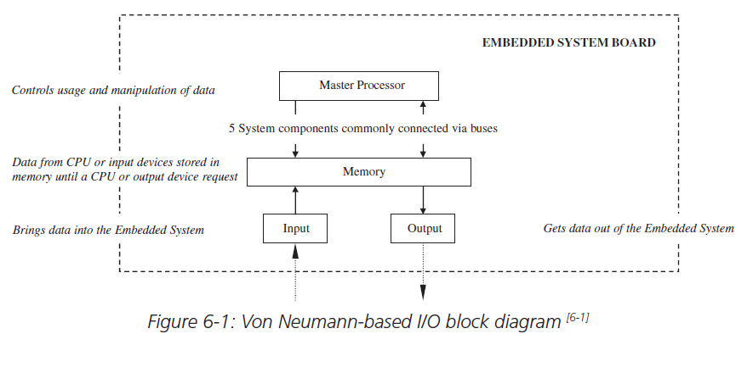
Board I/O - Introduction
I/O Components !!!
Responsible for moving information into and out of the board to I/O devices connected to an embedded system.
Input components: bring information from an input device to the master processor.
Output components: take information out of the master processor to an output device.
Components that do both – Networking Devices
Fig 1. Von Neumann-based I/O block diagram

Slide 4
I/O Devices Types
Input devices - Keyboard, mouse, remote control, vocal, etc.
Graphics and output devices - Touch screen, CRT, printers, LEDs, etc.
Storage I/O - Optical disk controllers, magnetic disk controllers, magnetic tape controllers, etc.
Debugging I/O - BDM, JTAG, serial port, parallel port, etc.
Networking and communications I/O.
Real time and miscellaneous I/O - timers/counters, analog-to-digital converters and digital-to-analog converters, key switches, and so on.

Slide 5
I/O Hardware - Logical units
Transmission medium - a wireless or wired medium connecting the I/O device to the embedded board.
Use: data communication and exchanges.
Communication port: transmission medium connects to on the board.
I/O controller: a slave processor that manages the I/O device.
Communication interface: manages data communication between master CPU and I/O controller.
Use: responsible for encoding and decoding
I/O buses: connection between the board I/O and master processor
Master processor integrated I/O

Slide 6
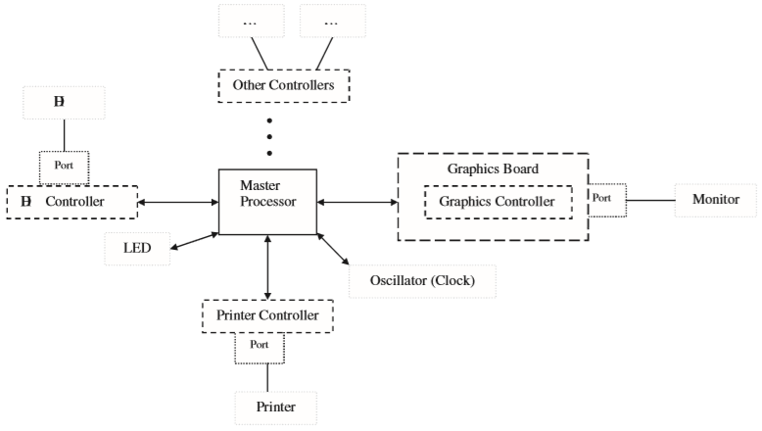
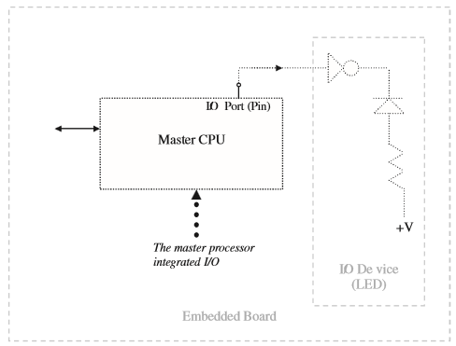
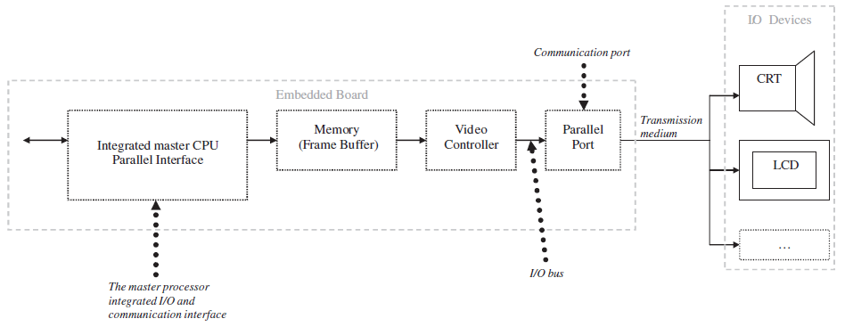
Fig2. Ports and device controllers on an embedded board
Fig3. Simple I/O Subsystem
Fig4. Complex I/O Subsystem

Slide 7
Serial I/O
Components in which data (characters) are stored, transferred and received one bit at a time.
It is typically made up of some combination of the six main logical units.
Serial interfaces handles the serial data transmission and reception between the master CPU and either the I/O device or its controller.
Serial data transmission and reception schemes - direction data can be transmitted and received.
Serial I/O data communication – Simplex, half duplex, Full duplex schemes
Data can be transmitted between two devices three different ways:
Data stream can only be transmitted - One direction
Data stream can be transmitted and received in either direction - only one direction at any one time.
Data stream can be transmitted and received in either direction simultaneously.

Slide 8
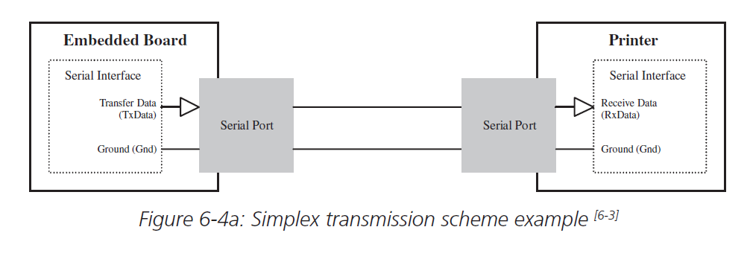
Simplex scheme
Simplex scheme is one in which a data stream can only be transmitted and received in the one direction
Example: Radio Broadcasting, Computer to printer
Fig 5. Simplex transmission scheme

Slide 9
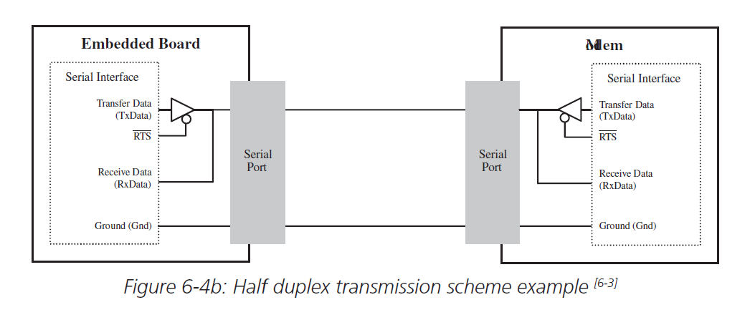
Half-Duplex Scheme
A half duplex scheme is one in which a data stream can be transmitted and received in either direction, but in only one direction at any one time
Example: walkie-talkie
Fig 6. Half duplex transmission scheme

Slide 10
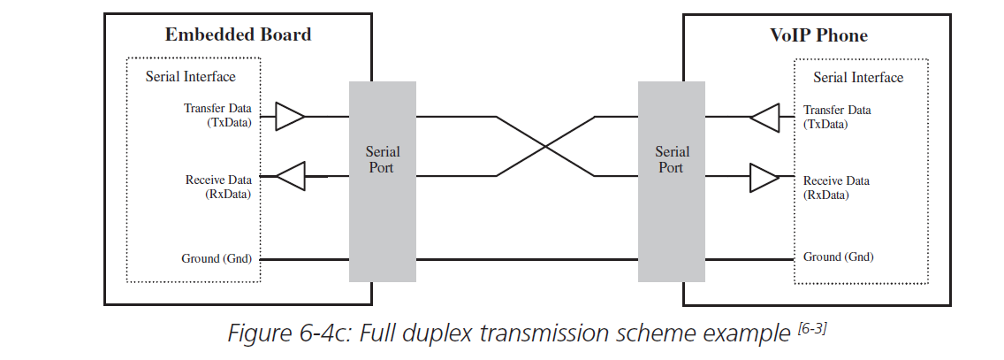
Full duplex Scheme
A full duplex scheme is one in which a data stream can be transmitted and received in either direction simultaneously
Example: All smart phone calls
Fig 7. Full duplex transmission scheme

Slide 11
Synchronous Vs Asynchronous transfer
Serial I/O transfers can occur either as
Synchronous transfer: Steady stream at regular intervals regulated by the CPU’s clock.
Asynchronous transfer: Intermittently at irregular (random) intervals.

Slide 12
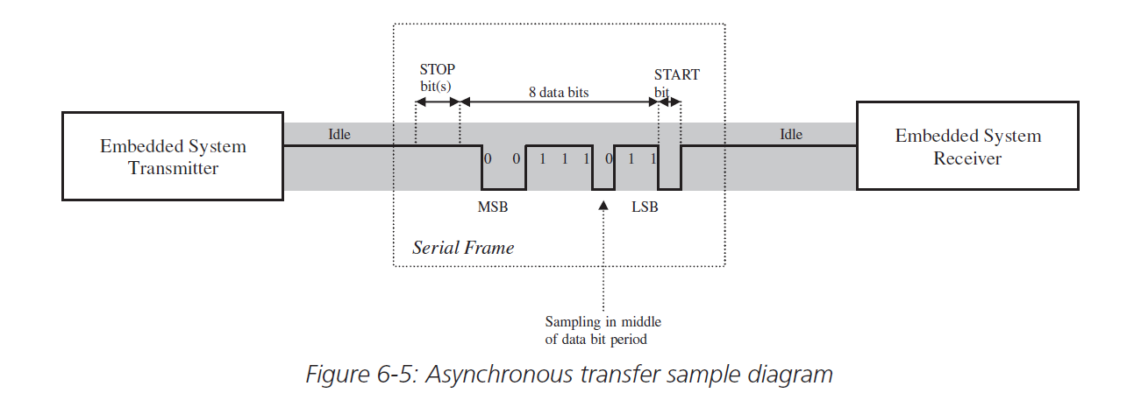
Asynchronous transfer
In an asynchronous transfer, the data being transmitted is stored and modified within a serial interface’s transmission buffer.
The serial interface at the transmitter divides the data stream into groups, called packets.
Packets of size 4 to 8 bits per character/ 5 to 9 bits per character.
Asynchronous transfer

Slide 13
Asynchronous transfer
Each of these packets is then encapsulated in frames to be transmitted separately.
The frames are packets modified in order to include the “START” bit, “STOP” bit and a parity bit.
START bit - Start of a frame, STOP bit - End of a frame
Parity bit - basic error checking (Optional) – Even parity/Odd parity
Parity for a serial transmission can be NONE. No parity bit - No error checking.
Between the transmission of frames, the communication channel is kept in an idle state or non-return to zero (NRZ) state

Slide 14
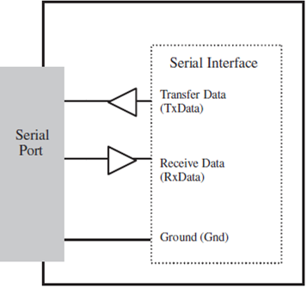
Asynchronous transfer
The serial interface of the receiver
Receives frames by synchronizing to the START bit of a frame.
Delays for a brief period, and then shifts in bits, one at a time, into its receive buffer until reaching the STOP bit (s).
Bit rate = (number of actual data bits per frame/total number of bits per frame) * the baud rate.
Bit rate = (8/12) * 100 Mbps = 66.7 Mbps.
Transmitter’s serial interface and the receiver’s serial interface synchronize with separate bit-rate clocks to sample data bits

Slide 15
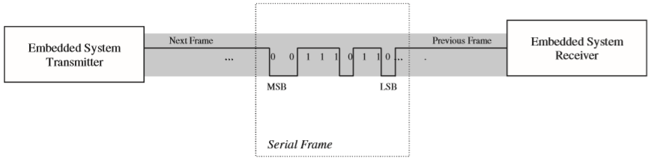
Synchronous transfer
There are no START or STOP bits appended to the data stream.
There is no idle period.
Asynchronous transmissions, the data rates Tr and Rr must be in sync and separate clocks used.
In a synchronous transmission are synchronizing off of one common clock.
UART (universal asynchronous receiver-transmitter)
serial interface - asynchronous serial transmission.
SPI (serial peripheral interface)
synchronous serial interface
Conclusion: Serial Interface - slave ICs on the board/integrated onto the master processor.
Transmits data to and from an I/O device via a serial port.
Converting data that is coming to and from the serial port - data that the master CPU can process.
Synchronous transfer

Slide 16
Parallel I/O
Devices which can transfer data in multiple bits simultaneously.
Parallel I/O hardware is also made up of some combination of six logical units.
Communication port - Parallel port and communication interface - Parallel interface.
Parallel interfaces
manage the parallel data transmission and reception - Master CPU and either the I/O device or its controller.
decoding and encoding data bits on the parallel port.
reception and transmission buffers to store and manipulate the data being transferred.
parallel data transmission and reception schemes – direction, actual process of transmitting/receiving data bits.
Direction - simplex, half-duplex, or full-duplex modes.
Actual process - parallel I/O devices can transmit data asynchronously or synchronously.
Parallel I/O have a greater capacity.
Examples: IEEE 1284 controllers, CRT ports, and SCSI

Slide 17
Embedded Hardware: Hardware Building Blocks
CSPC61 - Embedded Systems Architectures
Board I/O
Dr. M. Bhuvaneswari
14.03.2022

Slide 18
Topics - Board I/O (Input/Output)
Introducing board I/O
Discussing differences between serial and parallel I/O
Introducing interfacing to I/O
Discussing I/O performance

Slide 19
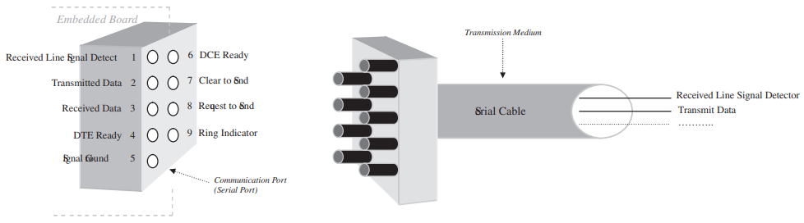
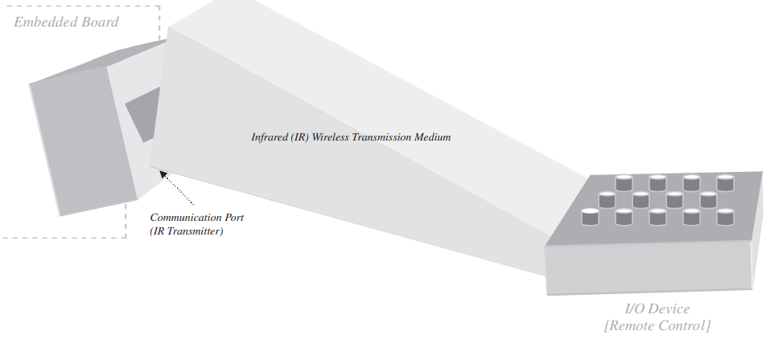
I/O Component Interfacing
I/O hardware is made up of all or some combination six main logical units.
All of these components are interfaced.
Communication mechanisms - hardware, software, or both.
Interfacing the I/O Device with the Embedded Board
For off-board I/O devices (keyboards, mice, LCDs, printers) - a transmission medium is used to interconnect the I/O device to an embedded board via a communication port.
Wireless transmission medium
Wired transmission medium

Slide 20
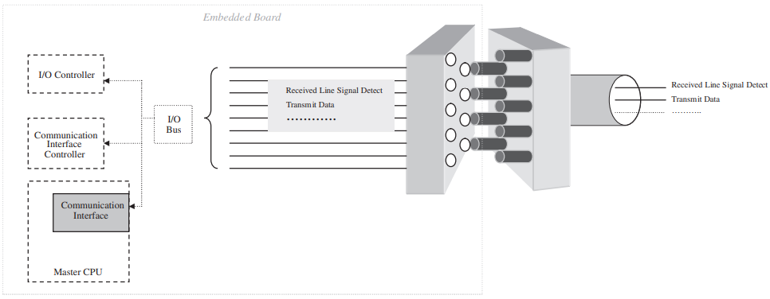
I/O Component Interfacing
Interfacing communication port to board I/O – I/O Controller, communication interface controller or the master processor via an |I/O Bus.
I/O Bus - a collection of wires transmitting the data.
On-board I/O devices can be connected directly to the master processor via I/O ports.
Off-board I/O devices can be connected indirectly using a communication interface integrated into the master processor or a separate IC on the board and the communication port.
the relative board I/O components are interconnected via I/O buses.

Slide 21
I/O Component Interfacing
Interfacing an I/O controller and Master CPU
I/O controller to manage the I/O device
Interface between the I/O controller and master CPU data – Based on 4 requirements
An ability of the master CPU to initialize and monitor the I/O Controller.
I/O controllers are configured via control registers and monitored via status registers.
Control registers - data registers - can modify to configure the I/O controller.
Status registers - read-only registers - the master processor can get information – State of the I/O controller.
A way for the master processor to request I/O.
Memory mapped I/O.
I/O mapped I/O.
A way for the I/O device to contact the master CPU.
Interrupt driven I/O.
I/O controller.
Some mechanism for both to exchange data.
How data is exchanged between the I/O controller and the master processor.
Programmed transfer
In memory-mapped I/O schemes - DMA circuitry - bypass the master CPU.
DMA has the ability to manage data transmissions or receptions directly to and from main memory and an I/O device.

Slide 22
I/O Performance
I/O performance is one of the most important issues of an embedded design.
Wide variety of I/O devices, each device have its own unique qualities.
Features of I/O - negatively impact board performance.
Data rates of the I/O devices
Characters per second - Keyboard or Mouse.
Mbytes per second - Networking, tape, disk.
Speed of the master processor
Clocks rates – 10 MHz to 100 MHz
How to synchronize the speed of the master processor to the speeds of I/O.
Realistic scheme must be implemented
How I/O and the master processor communicate
Intermediate dedicated I/O controller between the master CPU and I/O device.
I/O controller manages I/O for the master processor. Freeing up the CPU to process data more efficiently.
Communication scheme - interrupt driven, polled, or memory mapped.
To improve I/O performance - board designers - examine the various I/O and master processor communication schemes to ensure that every device can be managed successfully via one of the available schemes.
To synchronize - slower I/O devices and the master CPU - Status flags or interrupts
To synchronize - faster I/O devices than master CPU - DMA

Slide 23
I/O Performance
Most common units measuring performance of I/O
Throughput: The maximum amount of data per unit time that can be processed, in bytes per second.
The components with the lowest throughput are what drives the performance of the whole system.
The execution time of an I/O component: The amount of time it takes to process all of the data it is provided with.
The response time of an I/O component: It is the amount of time be tween a request to process data and the time the actual component begins processing.
Benchmark - accurately determine the type of performance to measure
I/O rate would depend on the number of storage accesses per second, including delays.

Slide 24
End Summary Topics Covered - Board I/O (Input/Output)
Introducing board I/O
Discussing differences between serial and parallel I/O
Introducing interfacing to I/O
Discussing I/O performance

Slide 25
Embedded Software: Device Drivers Device Drivers for Interrupt Handling
CSPC61 - Embedded Systems Architectures
Dr. M. Bhuvaneswari
19.03.2022

Slide 26
Topics – Device Drivers
Defining device drivers
Device Drivers for Interrupt-Handling
Memory Device Drivers

Slide 27
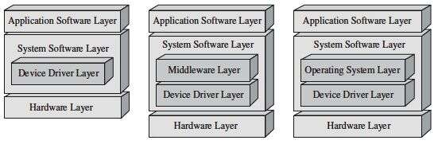
Device Drivers
Embedded hardware - software initialization and management.
Device Driver - Software directly interfaces with and controls the hardware.
Device drivers are the software libraries that initialize the hardware, and manage access to the hardware by higher layers of software.
Device drivers - hardware and the operating system, middleware, and application layers.
Embedded Systems Model and device drivers

Slide 28
Device Drivers
Von Neumann model - Device Drivers are required.
Master processor architecture-specific functionality.
Memory management drivers.
Bus initialization and transaction drivers.
I/O initialization and control drivers (networking, graphics, input devices, storage devices, debugging I/O)
Board and master CPU level.
Device drivers - Architecture-specific or generic
Device driver: Architecture-specific manages the hardware that is integrated into the master processor.
It is used initialize and enable components within a master processor (on-chip memory, integrated memory managers (MMUs), and floating point hardware)
Device driver - generic manages hardware that is located on the board and not integrated onto the master processor.
Generic drivers include code that initializes and manages access to the remaining major components of the board, including board buses, off-chip memory, and off-chip I/O.

Slide 29
Device Drivers - Functions
Hardware Startup, initialization of the hardware upon power-on or reset.
Hardware Shutdown, configuring hardware into its power-off state.
Hardware Disable, allowing other software to disable hardware on-the-fly.
Hardware Enable, allowing other software to enable hardware on-the-fly.
Hardware Acquire, allowing other software to gain singular (locking) access to hardware.
Hardware Release, allowing other software to free (unlock) hardware.
Hardware Read, allowing other software to read data from hardware.
Hardware Write, allowing other software to write data to hardware.
Hardware Install, allowing other software to install new hardware on-the-fly.
Hardware Uninstall, allowing other software to remove installed hardware on-the-fly.
Device drivers may have additional functions
These functions are based upon the software’s implicit perception of hardware.
Hardware - three states at any given time - Inactive, Busy, or Finished.
Inactive - disconnected, without power or disabled.
Busy - Active hardware state - Actively processing some type of data.
Finished – Data processing is completed - idle state.

Slide 30
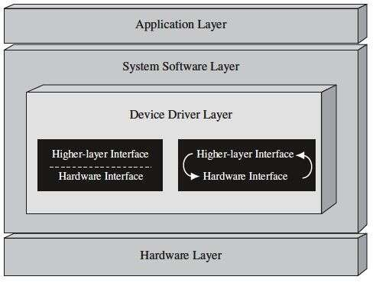
Device Drivers – Code Layers
Device drivers - can integrate all or some of these functions into single larger functions.
Each of these driver functions has code
interfaces directly to the hardware.
interfaces to higher layers of software.
Different types of software can execute in different modes: supervisory and user modes.
Device driver code typically runs in supervisory mode.
Driver code layers

Slide 31
Device Drivers - Interrupt Handling
Interrupts are signals triggered by some event during the execution of an instruction stream by the master processor.
It can be initiated asynchronously or synchronously.
It causes the master processor to stop executing the current instruction stream and start the process of handling the interrupt.
Interrupt Service Routine (ISR), Interrupt vector table (IVT)
Interrupt-handling device drivers supported functions
Interrupt-Handling Startup - Initialization of the interrupt hardware upon power-on or reset.
Interrupt-Handling Shutdown - configuring interrupt hardware into its power-off state.
Interrupt-Handling Disable - allowing other software to disable active interrupts on-the-fly.
Interrupt-Handling Enable - allowing other software to enable inactive interrupts on-the-fly.
Interrupt-Handler Servicing - Interrupt-handling code is executed after the interruption of the main execution stream.

Slide 32
CPU Processes Interrupts
Stop processing of current instruction.
Save program counter and flags to stack.
Run interrupt service routine.
Restore program counter and flags from stack.
Resume to the main program.
ISR – Subroutine used to service an interrupt. Each interrupt has an ISR which has an address listed in Interrupt vector table (IVT).
Processor obtains the subroutine address from the IVT and directs the execution to the ISR.

Slide 33
Device Drivers - Interrupt Handling
Implementation of startup, shutdown, disable, enable, and service functions depends on the following criteria
The types, number, and priority levels of interrupts available.
How interrupts are triggered.
The interrupt policies of components within the system that trigger interrupts, and the services provided by the master CPU processing the interrupts.
Three types of interrupts - software, internal hardware, and external hardware.
1. Software interrupts: Explicitly triggered by some instruction within the current instruction stream being executed by the master processor.
2. Internal hardware interrupts: Initiated by an event that is a result of a problem with the current instruction stream - executed by the master processor - features/limitations of the hardware. 1 and 2 are also referred to as exceptions or traps.
illegal math operations (overflow, divide-by-zero), debugging (single-stepping, breakpoints), invalid instructions (opcodes), and so on.
3. External hardware interrupts: Initiated by hardware other than the master CPU (board buses and I/O).

Slide 34
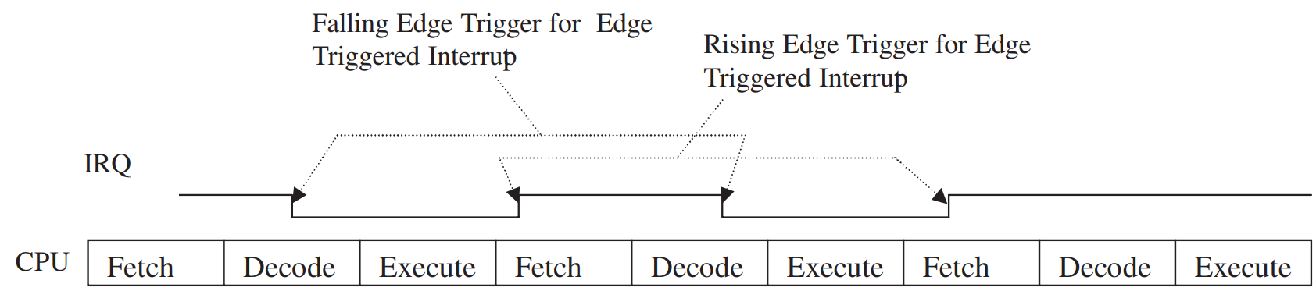
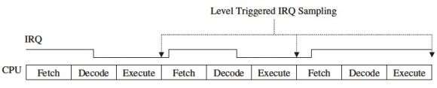
Device Drivers - Interrupt Handling
Interrupts are triggered - 2 ways: level-triggered or edge-triggered.
A level-triggered interrupt is initiated when its interrupt request (IRQ) signal is at a certain level (H or L).
These interrupts are processed by the CPU.
when the CPU finds a request for a level-triggered interrupt when sampling its IRQ line, such as at the end of processing each instruction.
Edge-triggered interrupts are triggered when a change occurs on the IRQ line. Once triggered, these interrupts latch into the CPU until processed.
Edge-Triggered Interrupts
Level-Triggered Interrupts

Slide 35
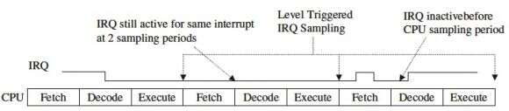
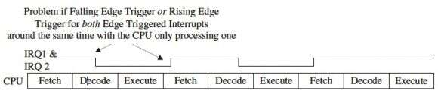
Device Drivers - Interrupt Handling
Level-triggered interrupts
Drawbacks
if the request is being processed and has not been disabled before the next sampling period, the CPU will try to service the same interrupt again.
if the level-triggered interrupt were triggered and then disabled before the CPU’s sample period, the CPU would never note its existence and would therefore never process it.
Interrupt signals - very short or very long : edge-triggered interrupts are recommended.
Edge-triggered interrupts
Drawbacks
Edge-triggered interrupts could have problems if they share the same IRQ line, if they were triggered in the same manner at the same time, resulting in the CPU being able to detect only one of the interrupts.
Interrupt signal share IRQ lines - level-triggered interrupts are recommended.

Slide 36
Device Drivers - Interrupt Handling
Master processor receives an interrupt signal (IRQ line), interrupt-handling mechanisms process the interrupt.
Interrupt-handling mechanisms - both hardware and software components.
Hardware - an interrupt controller (integrated onto a board/within a processor) - mediate interrupt transactions in conjunction with software.
X86 Architectures - 2 PICs, MIPS32 - an external interrupt controller, MPC860 - 2 Interrupt controllers.
Mitsubishi M37267M8 TV microcontroller - no interrupt controller – IRQ line are connected to the master processor directly.
Interrupt transactions are controlled via software and some internal circuitry (registers, counters)
When an interrupt was created by the external device, Interrupt acknowledgment (IACK) is also handled by the master processor.
an external device triggering an interrupt - the interrupt scheme - device can provide an interrupt vector or devices that cannot provide an interrupt vector (non vectored interrupt).
Non vectored interrupt - master processors implement an auto-vectored interrupt scheme in which one ISR is shared by the non-vectored interrupts.

Slide 37
Interrupt Handling – Interrupt Priorities
Embedded board has multiple components - need to request interrupts
Priority based interrupt handling - all available interrupts within a processor have a level (Priority).
Interrupt with level ‘1’ - Highest priority
Interrupts with higher levels have precedence over any instruction stream being executed by the master processor.
not only do interrupts have precedence over the main program
The interrupt with the highest priority is usually called a non-maskable interrupt (NMI)
When an interrupt is triggered, lower priority interrupts are masked - they are not allowed to trigger when the system is handling a higher-priority interrupt.
Various architectures - Several different priority schemes are implemented.
Three models : equal single level, static multilevel, dynamic multilevel.
Equal single level - Latest interrupt to be triggered gets the CPU.
Static multilevel - priorities are assigned by a priority encoder, highest priority interrupt gets the CPU
Dynamic multilevel - priorities are assigned by a priority encoder, priorities are reassigned when a new interrupt is triggered.

Slide 38
Interrupt Handling - Context Switching
After the hardware mechanisms have determined which interrupt to handle, the current instruction stream is halted and a context switch is performed.
Context switching - a process - the master processor switches from executing the current instruction stream to another set of instructions - interrupt service routine (ISR) or interrupt handler.
The specific ISR executed for a particular interrupt depends on whether a non-vectored or vectored scheme
Non-vectored interrupt - PC contains the start of an ISR
The ISR code determines the source of the interrupt and provides the appropriate processing.
Vectored interrupt - an interrupt vector table contains the address of the ISR.

Slide 39
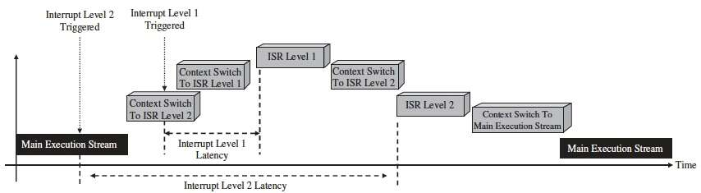
Interrupt Handling and Performance
The performance of an embedded design is affected by the latencies – Interrupt handling scheme.
Interrupt latency – Time difference between when an interrupt is triggered and ISR starts executing.
Interrupt handling scheme - Interrupt request and acknowledge the interrupt, obtaining an interrupt vector (in a vectored scheme), and context switching to the ISR.
The interrupt latency for the original lower priority interrupt increases to include the time in which the higher priority interrupt is handled.
Interrupt latency

Slide 40
Topics Covered
Defining device drivers
Device Driver Functions
Device Drivers for Interrupt-Handling
Interrupt
How CPU Process interrupts
How Interrupt triggered
Interrupt Handling Schemes
Types of Interrupts
Interrupt Priorities
Context Switching
Interrupt Handling and Performance

